Slide 1
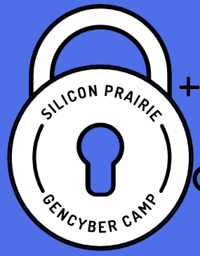



Cyber Toolkits

Slide 2
Cybersecurity First Principles
Domain Separation
Process Isolation
Resource Encapsulation
Least Privilege
Layering
Abstraction
Information Hiding
Modularity
Simplicity of Design
Minimization

Slide 3
Cyber Toolkit
Microsoft SysInternals
Wireshark
VMWare Player / VirtualBox

Slide 4
Building your Toolkit
13 must-have security tools
Vuln Hub: https://www.vulnhub.com/
Resources
Brainpan, http://blog.techorganic.com/
Challenge sites: http://www.wechall.net/
What’s in Your [Security] Wallet?
My Security Bookshelf
SecTools.org
Oldergeeks.com

Slide 5
Lists of tools, tips, & tricks
SecTools
The Geek Stuff
HowToGeek.com, Geek School
OlderGeeks
13 must-have security tools

Slide 6
Virtual Environments
Players
VMWare Player / Workstation
Oracle VM VirtualBox
Linux Distros
http://distrowatch.com/
http://livecdlist.com/

Slide 7
Cookie & Ad Blockers
Firefox NoScript
Ghostery
EFF Privacy Badger
Sandboxie

Slide 8
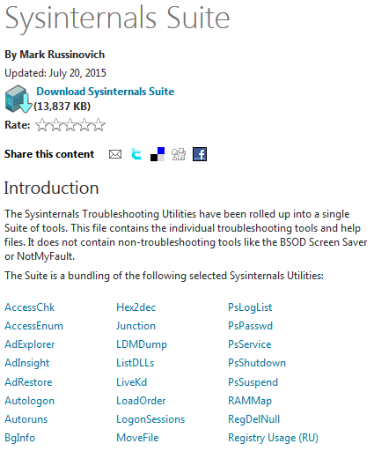
Windows Administration
SysInternals Suite
Autoruns
Process Explorer
Video:
Mark Russinovich, Malware Hunting

Slide 9
Microsoft eBooks
Eric Ligman Collection of FREE Microsoft eBooks
2014
2015

Slide 10
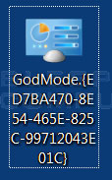
Windows Administration
GodMode
Create a new folder and edit it so that it is named the following and then press enter.
GodMode.{ED7BA470-8E54-465E-825C-99712043E01C}
When done, you should have an icon on your desktop

Slide 11
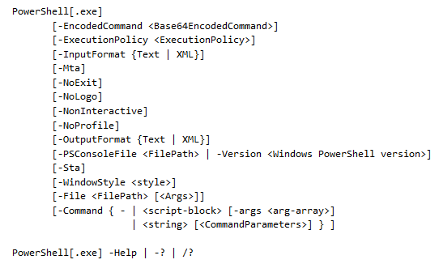
Windows Administration
PowerShell
Using Windows PowerShell
PowerShell.exe Command-Line Help

Slide 12
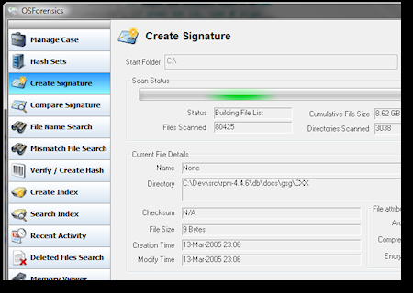
Forensics
OSForensics
WinHex

Slide 13
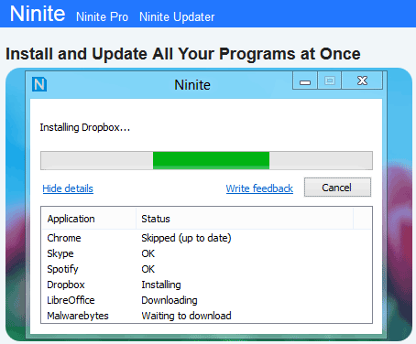
Patching & Updating
Ninite (https://ninite.com/)

Slide 14
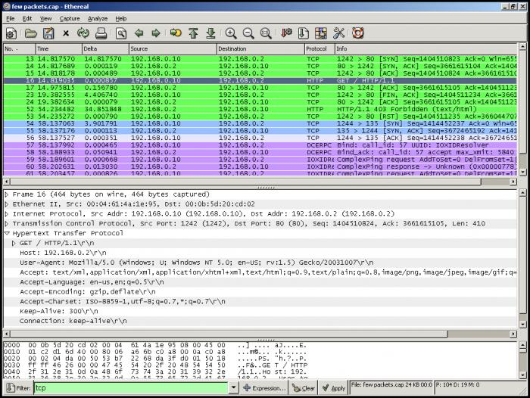

Network Evaluation
Wireshark
Introduction video

Slide 15
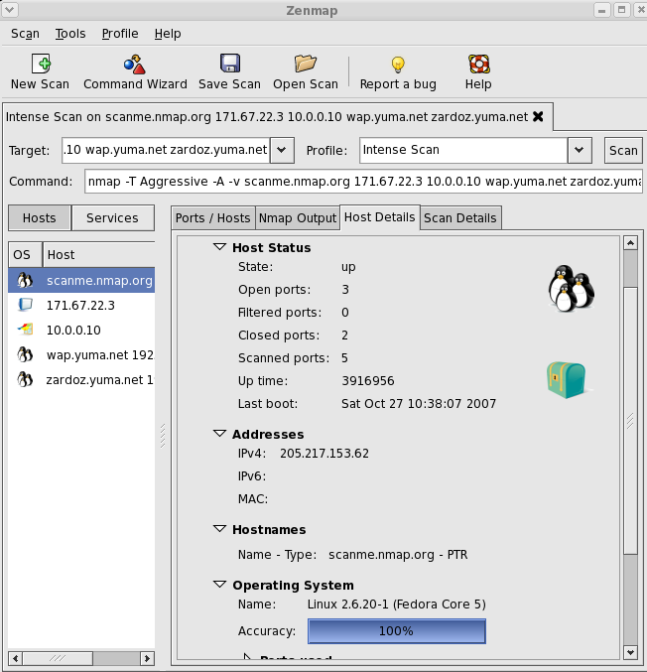
Network Evaluation
Nmap / ZenMap

Slide 16
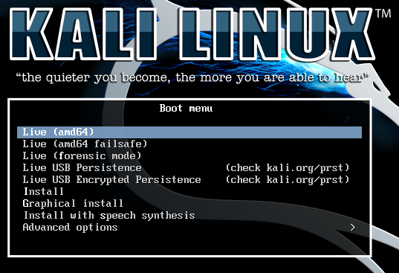

Slide 17
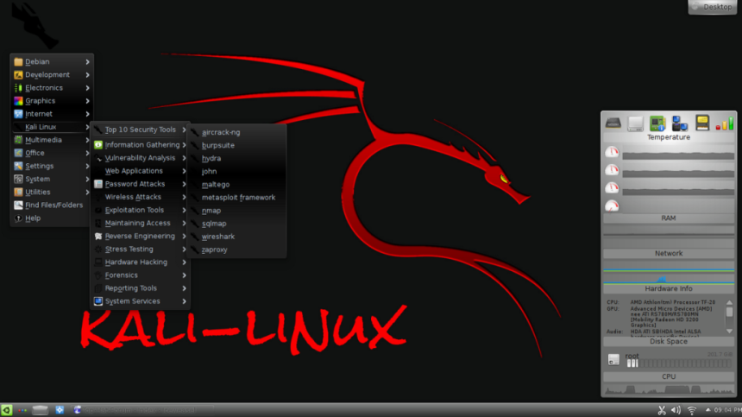
Kali Linux
Kali Linux is a Debian-derived Linux distribution, designed for digital forensics and penetration testing.
Kali Linux is preinstalled with numerous penetration-testing programs.
Kali Linux can be run from a hard disk, live CD, or live USB. It is a supported platform of the Metasploit Project's Metasploit Framework, a tool for developing and executing security exploits.
From the creators of BackTrack comes Kali Linux, the most advanced penetration testing distribution created till now.
17

Slide 18
Others?
What are your favorite tools / apps / etc.

